Slide 1
An introduction to sensitivity analysis
(2021.06.18.)

Slide 2
1. References
John Norton - An introduction to sensitivity assessment of simulation models → Environmental Modelling & Software 69 (2015) 166-174
Francesca Pianosi, et. al. - Sensitivity analysis of environmental models: A systematic review with practical workflow → Environmental Modelling & Software 79 (2016) 214-232
I.M. Sobol’ - Global sensitivity indices for nonlinear mathematical models and their Monte Carlo estimates → Mathematics and Computers in Simulation 55 (2001) 271–280
SALib - Sensitivity Analysis Library in Python → https://salib.readthedocs.io/en/latest/

Slide 3
2. What is sensitivity assessment?
Sensitivity assessment (or sensitivity analysis (SA)) investigates the relations between parameters and outputs of a simulation model.
Parameters – equation coefficients, threshold values in model, and features of input (forcing) variables.
(u > tv) y = p₁u₁ + p₂u₂ / (1 – p₃u₁)
Equation coefficients: p₁, p₂, p₃
Threshold values: tv
Input (forcing) variables: u₁, u₂
Source: Environmental Modelling & Software 69 (2015) 166-174

Slide 4
2. What is sensitivity assessment?
For each output, in what order of importance do the parameters influence it?
Are there parameters which affect the outputs so little that the model should be rewritten without them?
How well can the combined effect of a collection of parameters be found by summing their individual effects?
Conversely, what are the significant interactions between parameters in their effect on an output?
How closely is an output change proportional to the change in parameter value which causes it?
More broadly, how does the effect of a given change in a parameter value vary with that value?
Source: Environmental Modelling & Software 69 (2015) 166-174

Slide 5
- Purposes (settings) of SA
input factor : any element that can be changed before model execution
Ranking (or Factor Priorization) aims at generating the ranking of the input factors according to their relative contribution to the output variability.
Screening (or Factor Fixing) aims at identifying the input factors, if any, which have a negligible influence on the output variability.
Mapping aims at determining the region of the input variability space that produces significant.
Source: Environmental Modelling & Software 79 (2016) 214-232

Slide 6
2. What is sensitivity assessment?
(John Norton) This paper calls SA sensitivity assessment rather than analysis, as it is much more often done by numerical experiment, looking at the results of model runs, than by analysis of the model's equations.
Sensitivity Analysis가 더 널리 사용되고 있는 표현
Source: Environmental Modelling & Software 69 (2015) 166-174

Slide 7
- Types of Sensitivity Analysis
input factor : any element that can be changed before model execution
Local Sensitivity Analysis
Local sensitivity analysis considers the output variability against variations of an input factors around a specific value.
Global Sensitivity Analysis
Global sensitivity analysis (or GSA) considers variations within the entire space of variability of the input factors.
Source: Environmental Modelling & Software 79 (2016) 214-232

Slide 8
- Types of Sensitivity Analysis
One-At-a-Time (OAT)
In OAT methods, output variations are induced by varying one input factor at a time, while keeping all others fixed.
All-At-a-Time (AAT)
In AAT methods, output variations are induced by varying all the input factors simultaneously, and therefore the sensitivity to each factor considers the direct influence of that factor as well as the joint influence due to interactions.
Source: Environmental Modelling & Software 79 (2016) 214-232

Slide 9
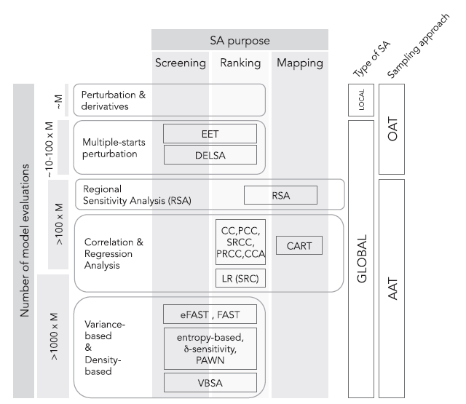
- Types of Sensitivity Analysis
지난번 설명에서 잘못된 부분
- Local sensitivity analysis여도 All-At-a-Time으로 분석 할 수 있음
Fig. 3. Classification system of Sensitivity Analysis methods based on computational complexity
M: Number of input factors subject to SA
Source: Environmental Modelling & Software 79 (2016) 214-232

Slide 10

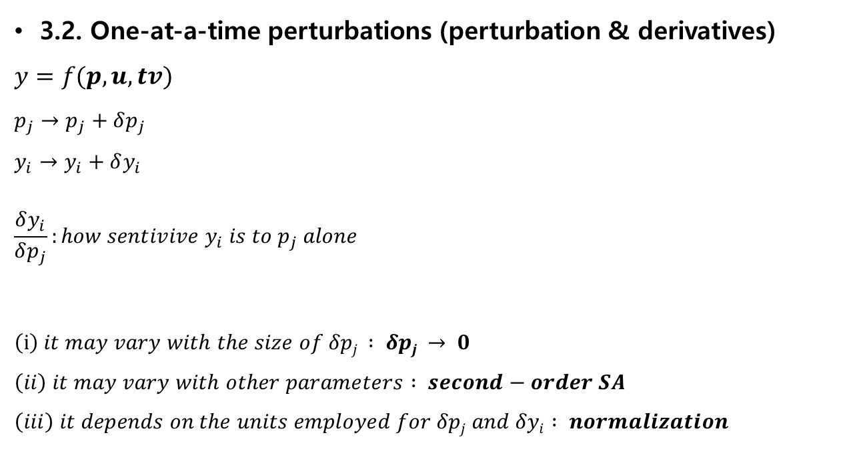
3. SA techniques
O$utput variable:y$
$$Equation coefficient:p$$
$$Threshold value: tv$$
$$Input (forcing) variables:u$$
3.2. One-at-a-time perturbations (perturbation & derivatives)
$$y=f(p, u,tv)$$
$$p_{j}→p_{j}+δp_{j}$$
$$y_{i}→y_{i}+δy_{i}$$
$$\frac{δy_{i}}{δp_{j}}:how sentivive y_{i} is to p_{j} alone$$
$$\left(i\right) it may vary with the size of δpj : δpj → 0$$
$$\left(ii\right) it may vary with other parameters : second−order SA$$
$$\left(iii\right) it depends on the units employed for δpj and δyi : normalization$$
Source: Environmental Modelling & Software 69 (2015) 166-174

Slide 11

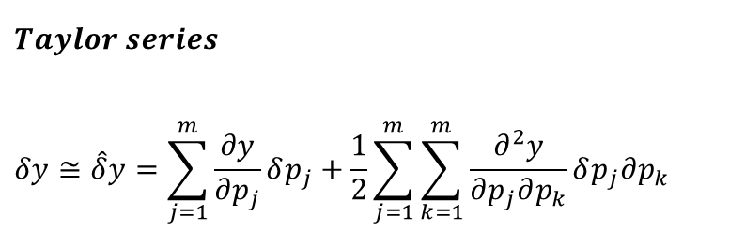
3. SA techniques
O$utput variable:y$
$$Equation coefficient:p$$
$$Threshold value: tv$$
$$Input (forcing) variables:u$$
3.2. One-at-a-time perturbations
$$1^{st}−order SA:$$
$$\lim_{δp_{j}→0}{\frac{δy_{i}}{δp_{j}}=\frac{p_{j}}{y_{i}}\frac{∂y_{i}}{∂p_{j}}} → s_{ij}≡\frac{p_{j}}{y_{i}}\frac{∂y_{i}}{∂p_{j}}$$
$$2^{nd}−order SA:$$
$$s_{jk}^{′}=\frac{p_{j}p_{k}}{y}\frac{∂^{2}y}{∂p_{j}∂p_{k}}$$
$$s_{jj}^{′}=\frac{1}{2}\frac{p_{j}^{2}}{y}\frac{∂^{2}y}{∂p_{j}^{2}}$$
$$Taylor series$$
$$δy≅\hat{δ}y=\sum_{j=1}^{m}{\frac{∂y}{∂p_{j}}δp_{j}+\frac{1}{2}}\sum_{j=1}^{m}{\sum_{k=1}^{m}{\frac{∂^{2}y}{∂p_{j}∂p_{k}}δp_{j}∂p_{k}}}$$
Source: Environmental Modelling & Software 69 (2015) 166-174

Slide 12
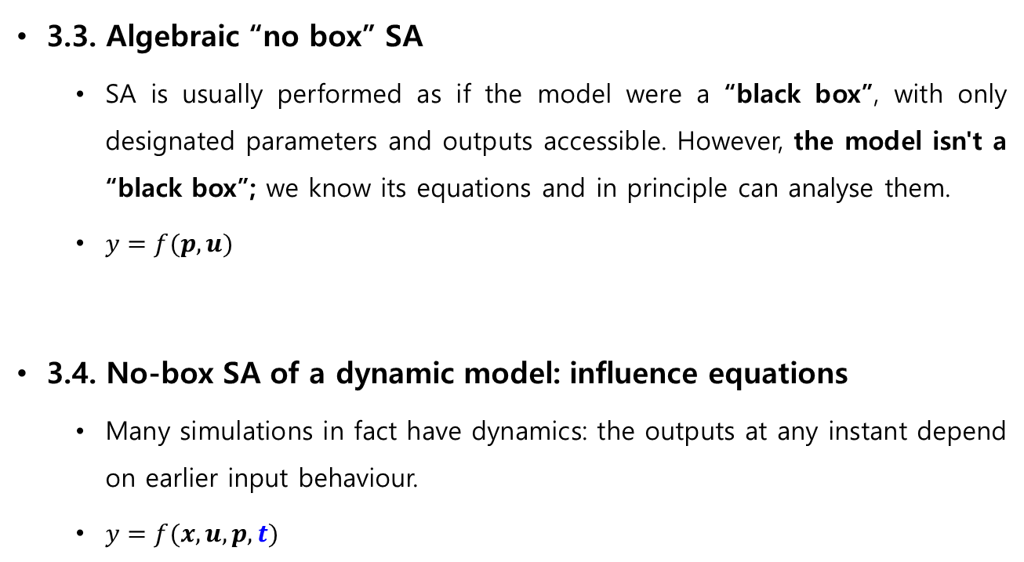
3. SA techniques
3.3. Algebraic “no box” SA
SA is usually performed as if the model were a “black box”, with only designated parameters and outputs accessible. However, the model isn't a “black box”; we know its equations and in principle can analyse them.
$y=f(p, u)$
3.4. No-box SA of a dynamic model: influence equations
Many simulations in fact have dynamics: the outputs at any instant depend on earlier input behaviour.
$y=f(x, u,p, t)$
Source: Environmental Modelling & Software 69 (2015) 166-174

Slide 13
3. SA techniques
3.3. Sampling-based SA
3.5.1. Introduction
We want to explore sensitivity over the whole range of credible model parameters with an acceptable computational load.
The best we can do is sample the output at as many points as we can afford, trying to spread them well, and reduce the volume of results to be examined by averaging in some way over the whole range of the parameters
Source: Environmental Modelling & Software 69 (2015) 166-174

Slide 14
3. SA techniques
3.5.2. Importance (stratified) sampling
The idea is to give each of a number of regions in parameter space an equal quota of samples, randomly distributed within each region.
3.5.3. Latin hypercube sampling
For each parameter of the m making up p, its range is split into N equal probability divisions and one sample taken in each division.
An m-vector of parameter values is then made up by random choice from the samples for each parameter. The next vector is formed by random choices from the N-1 remaining samples, and so on until we have used up all the samples. We thus generate sample points in only N of the N^{m} subdivisions, in contrast to one or more per subdivision in importance sampling.
Source: Environmental Modelling & Software 69 (2015) 166-174

Slide 15
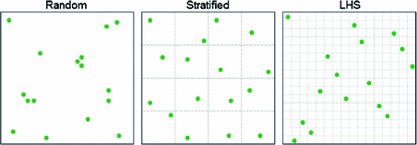
3. SA techniques
Graphical illustration (N = 16)
Importance (stratified) sampling
Latin hypercube sampling
p₁
p₁
p₂
p₂
Source: Numerical Analysis and Its Applications p302-310

Slide 16
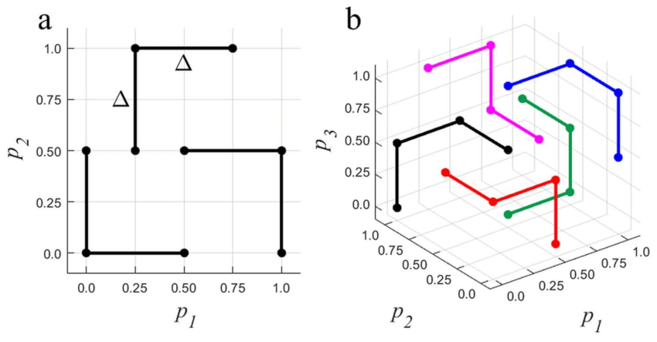
3. SA techniques
3.5.4. The Morris screening method
The method works by stepping m parameters along r trajectories, where r is typically less than m. Each trajectory consists of m single-parameter steps. The parameters are all perturbed once, in turn, on the trajectory.
5
6
a. m = 2, r = 3
b. m = 3, r = 5
3
7
8
4
2
1
9
Source: Environmental Modelling & Software 69 (2015) 166-174; Journal of Applied Physics 126, 184901 (2019)

Slide 17

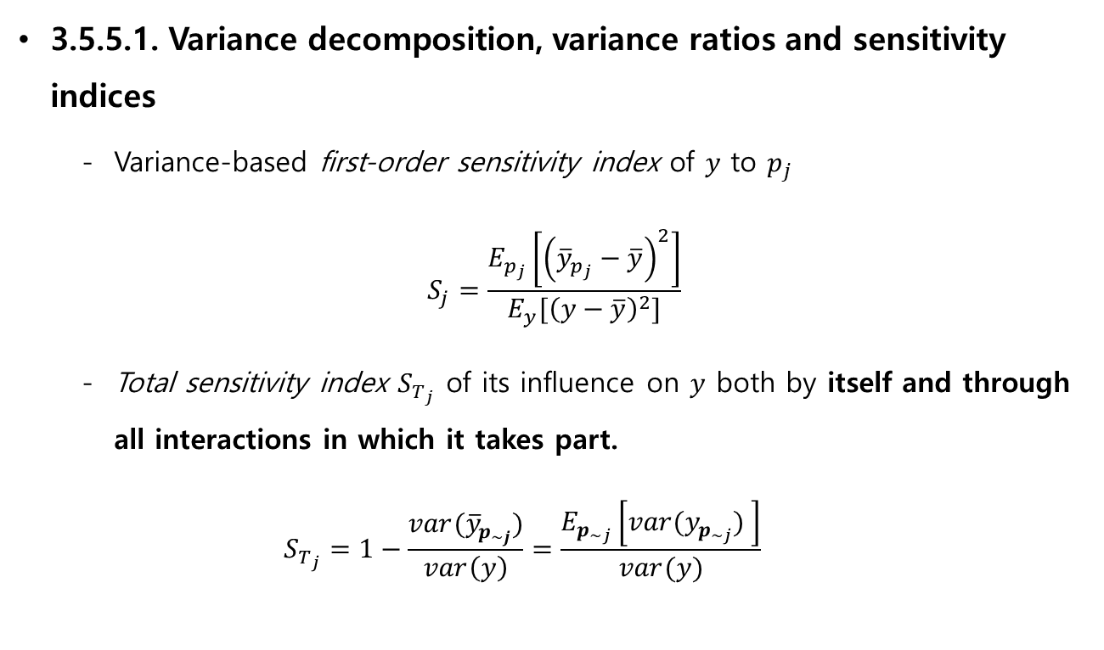
3. SA techniques
$p$: set of parameters
$p’$: subset of the parameters $p$
$p_{\sim j}$: the collection of all parameters except $p_{j}$
$y$: output
$\overline{y}$: mean of output
$y_{p^{′}}$: output for $p’$
3.5.5.1. Variance decomposition, variance ratios and sensitivity indices
Variance-based first-order sensitivity index of $y$ to $p_{j}$
$$S_{j}=\frac{E_{p_{j}}\left[{\left({\overline{y}}_{p_{j}}−\overline{y}\right)}^{2}\right]}{E_{y}[{\left(y−\overline{y}\right)}^{2}]}$$
Total sensitivity index $S_{T_{j}}$ of its influence on $y$ both by itself and through all interactions in which it takes part.
$$S_{T_{j}}=1−\frac{var({\overline{y}}_{p_{\sim j}})}{var\left(y\right)}=\frac{E_{p_{\sim j}}\left[var(y_{p_{\sim j}}) \right]}{var(y)}$$
Source: Environmental Modelling & Software 69 (2015) 166-174

Slide 18

3. SA techniques
3.5.5.1. Variance decomposition, variance ratios and sensitivity indices
Example 1. $p=\left(p_{1}, p_{2}, p_{3}\right)$
$S_{{(p}_{1})}=S_{p_{1}}→S_{{(p}_{i})}=S_{p_{i}}$
$S_{{(p}_{1})}^{tot}=S_{p_{1}}+S_{p_{1}p_{2}}+S_{p_{1}p_{3}}+S_{p_{1}p_{2}p_{3}}=1−S_{(p_{2},p_{3})}$
Source: Environmental Modelling & Software 69 (2015) 166-174;
Mathematics and Computers in Simulation 55 (2001) 271–280

Slide 19
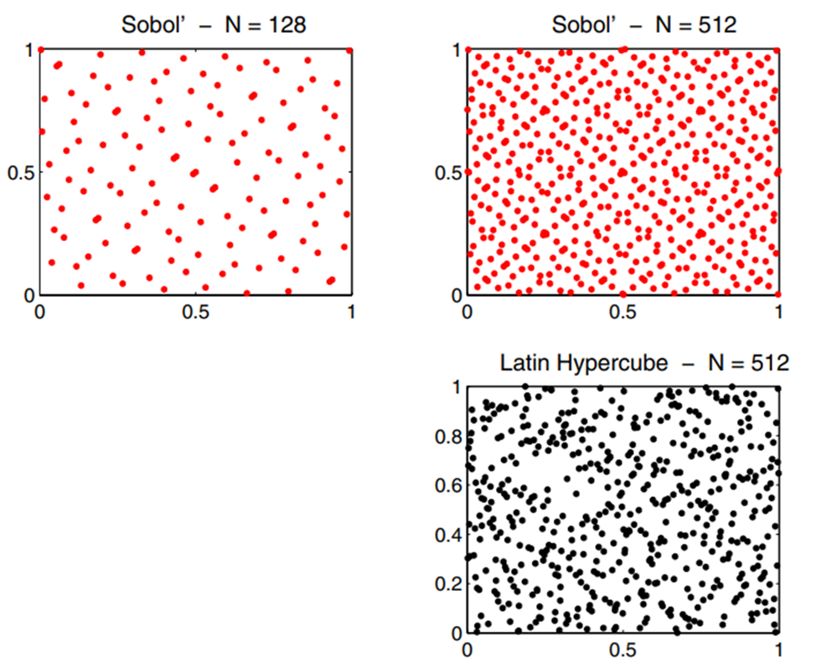

- Sobol’ sampling scheme
Sobol’ sequences: quasi random low-discrepancy sequences
Discrepancy is a measurement of the highest or lowest density of points in a sequence. High discrepancy means that there is either a large area of empty space, or that there is an area that has a high density of points. Low discrepancy means that there are neither, and that your points are more or less pretty evenly distributed.
High discrepancy
Low discrepancy
$$N:number of samples (2^{n})$$
Source: Mecanique & Industries 8, 289–297 (2007);
https://blog.demofox.org/2017/05/29/when-random-numbers-are-too-random-low-discrepancy-sequences/

Slide 20

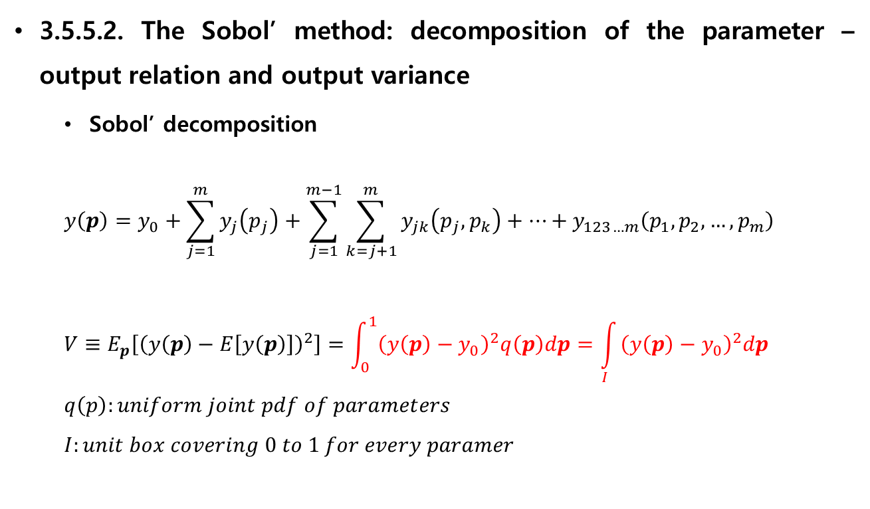
3. SA techniques
$$p: set of parameters$$
$$y: output$$
$$y_{0}:E\left[y\left(p\right)\right]$$
$$V:variance$$
$$S:sensitivity \left(S_{j}= \frac{V_{j}}{V}, S_{jk}=\frac{V_{jk}}{V}\right)$$
3.5.5.2. The Sobol’ method: decomposition of the parameter – output relation and output variance
Sobol’ decomposition
$$y\left(p\right)=y_{0}+\sum_{j=1}^{m}{y_{j}\left(p_{j}\right)}+\sum_{j=1}^{m−1}{\sum_{k=j+1}^{m}{y_{jk}\left(p_{j},p_{k}\right)}}+…+y_{123…m}\left(p_{1},p_{2},…,p_{m}\right)$$
$$V≡E_{p}\left[{\left(y\left(p\right)−E\left[y\left(p\right)\right]\right)}^{2}\right]=\int_{0}^{1}{{\left(y\left(p\right)−y_{0}\right)}^{2}q\left(p\right)dp}=\int_{I}{{\left(y\left(p\right)−y_{0}\right)}^{2}dp}$$
$$q\left(p\right):uniform joint pdf of parameters$$
$$I:unit box covering 0 to 1 for every paramer$$
Source: Environmental Modelling & Software 69 (2015) 166-174

Slide 21
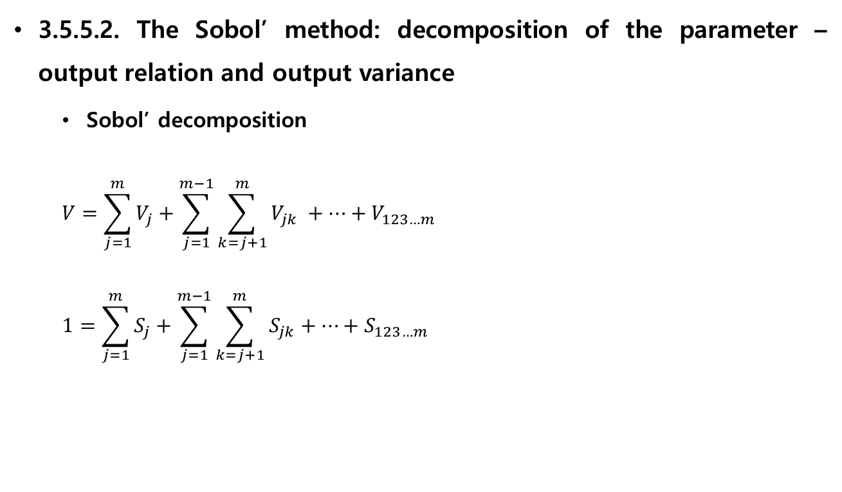
3. SA techniques
$$p: set of parameters$$
$$y: output$$
$$y_{0}:E\left[y\left(p\right)\right]$$
$$V:variance$$
$$S:sensitivity \left(S_{j}= \frac{V_{j}}{V}, S_{jk}=\frac{V_{jk}}{V}\right)$$
3.5.5.2. The Sobol’ method: decomposition of the parameter – output relation and output variance
Sobol’ decomposition
$$V=\sum_{j=1}^{m}{V_{j}}+\sum_{j=1}^{m−1}{\sum_{k=j+1}^{m}{V_{jk} }}+…+V_{123…m}$$
$$1=\sum_{j=1}^{m}{S_{j}}+\sum_{j=1}^{m−1}{\sum_{k=j+1}^{m}{S_{jk}}}+…+S_{123…m}$$
Source: Environmental Modelling & Software 69 (2015) 166-174

Slide 22
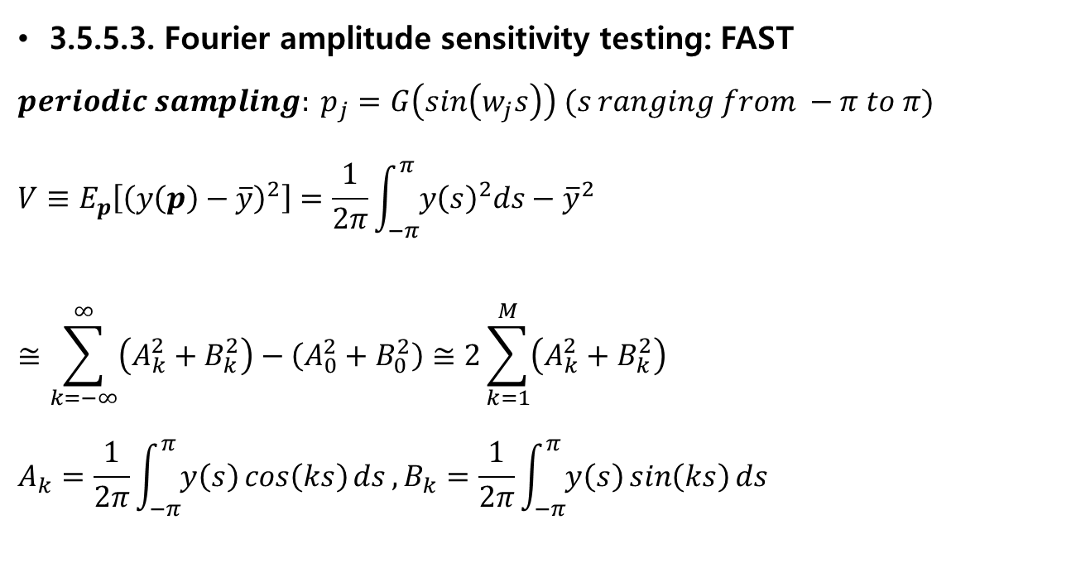
3. SA techniques
3.5.5.3. Fourier amplitude sensitivity testing: FAST
$$periodic sampling: p_{j}=G\left(\sin\left(w_{j}s\right)\right) (s ranging from −π to π)$$
$$V≡E_{p}\left[{\left(y\left(p\right)−\overline{y}\right)}^{2}\right]=\frac{1}{2π}\int_{−π}^{π}{y{\left(s\right)}^{2}ds}−{\overline{y}}^{2}$$
$$≅\sum_{k=−∞}^{∞}{\left(A_{k}^{2}+B_{k}^{2}\right)−\left(A_{0}^{2}+B_{0}^{2}\right)}≅2\sum_{k=1}^{M}{\left(A_{k}^{2}+B_{k}^{2}\right)}$$
$$A_{k}=\frac{1}{2π}\int_{−π}^{π}{y\left(s\right)\cos\left(ks\right)ds},B_{k}=\frac{1}{2π}\int_{−π}^{π}{y\left(s\right)\sin\left(ks\right)ds}$$
Source: Environmental Modelling & Software 69 (2015) 166-174

Slide 23
3. SA techniques
3.5.6. Regionalised SA (RSA): binary classification of Monte Carlo results
“What spread of parameter values meets every one of a list of requirements?”
Regional Sensitivity Analysis (RSA), also called Monte Carlo filtering, is a family of methods mainly aimed at identifying regions in the inputs space corresponding to particular values (e.g. high or low) of the output, and that can be used for mapping and for dominant controls analysis.
Example) Kolmogorov-Smirnov statistic
Source: Environmental Modelling & Software 69 (2015) 166-174; Environmental Modelling & Software 79 (2016) 214-232

Slide 24
4. Further reading
Saltelli, A., Chan, K., Scott, E.M., 2008a. Sensitivity Analysis, second ed. Wiley, Chichester, UK.
Saltelli, A., Ratto, M., Andres, T., Campolongo, F., Cariboni, J., Gatelli, D., Saisana, M., Tarantola, S., 2008b. Global Sensitivity Analysis: the Primer. Wiley, Chichester, UK.
Saltelli, A., Tarantola, S., Campolongo, F., Ratto, M., 2004. Sensitivity Analysis in Practice: a Guide to Assessing Scientific Models. Wiley, Chichester, UK.
etc.
Source: Environmental Modelling & Software 69 (2015) 166-174

Slide 25
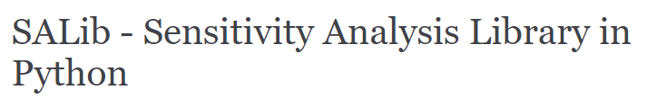
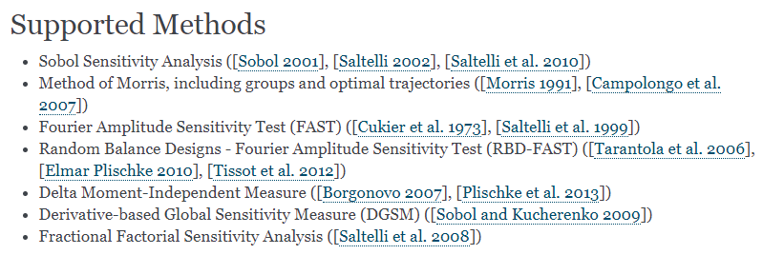
APPENDIX: Python Library - SALib
Source: https://salib.readthedocs.io/en/latest/

Slide 26
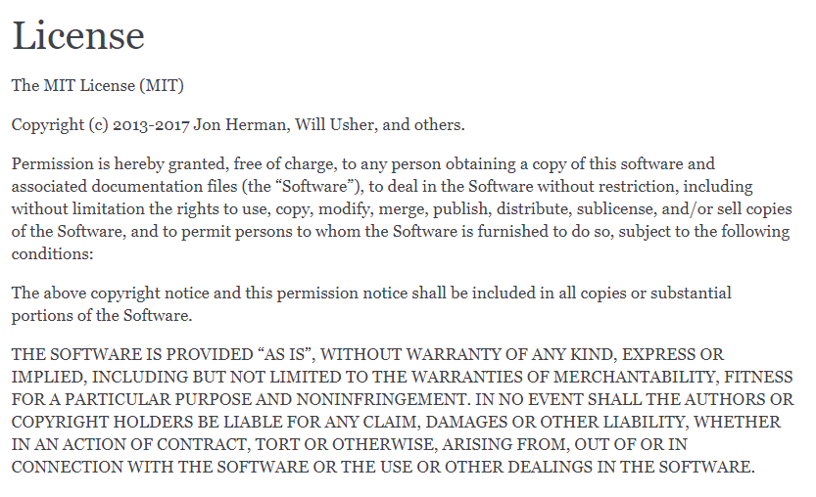
APPENDIX: Python Library - SALib
License의 기원이 MIT
Source: https://salib.readthedocs.io/en/latest/

Slide 27
APPENDIX: Python Library - SALib
$$f\left(x\right)=\sin\left(x_{1}\right)+a\sin^{2}\left(x_{2}\right)+bx_{3}^{4}sin\left(x_{1}\right)(Ishigami equation)$$
problem = {
'num_vars': 3,
'names': ['x1', 'x2', 'x3'],
'bounds': [[-3.14159265359, 3.14159265359],
[-3.14159265359, 3.14159265359],
[-3.14159265359, 3.14159265359]]
}
Sobol
Si : [0.311 0.455 0.014]
ST : [0.545 0.43 0.235]
x1-x2: -0.013
x1-x3: 0.229
x2-x3: -0.028
FAST
Si : [0.319 0.442 0. ]
ST : [0.571 0.469 0.239]
Morris
Mu* : [7.704 0.205 0.212]
sigma : [6.252 7.876 8.865]
Source: https://salib.readthedocs.io/en/latest/

Slide 28
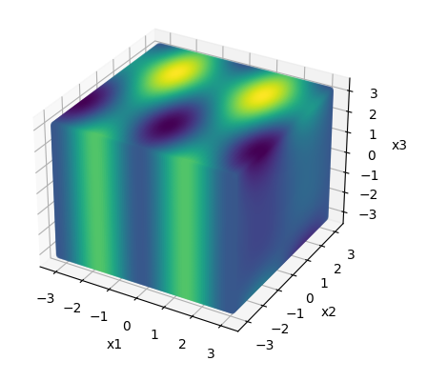
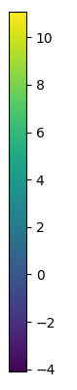
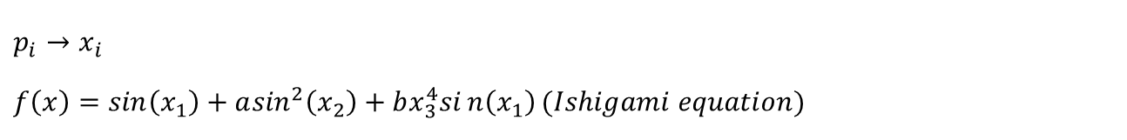
APPENDIX: Python Library - SALib
$$p_{i}→x_{i}$$
$$f\left(x\right)=\sin\left(x_{1}\right)+a\sin^{2}\left(x_{2}\right)+bx_{3}^{4}sin\left(x_{1}\right)(Ishigami equation)$$
Sobol
Si : [0.311 0.455 0.014]
ST : [0.545 0.43 0.235]
x1-x2: -0.013
x1-x3: 0.229
x2-x3: -0.028
FAST
Si : [0.319 0.442 0. ]
ST : [0.571 0.469 0.239]
Morris
Mu* : [7.704 0.205 0.212]
sigma : [6.252 7.876 8.865]
→ Sobol and FAST are more reasonable.
Source: https://salib.readthedocs.io/en/latest/

Slide 29
Thank you!

